Slide 1
PMS Road image on STATIC MAP (WPF)
2024.08.31
김 상 현
GPR 사업부 / 기술연구소
이성 주식회사

Slide 2
목차

Slide 3
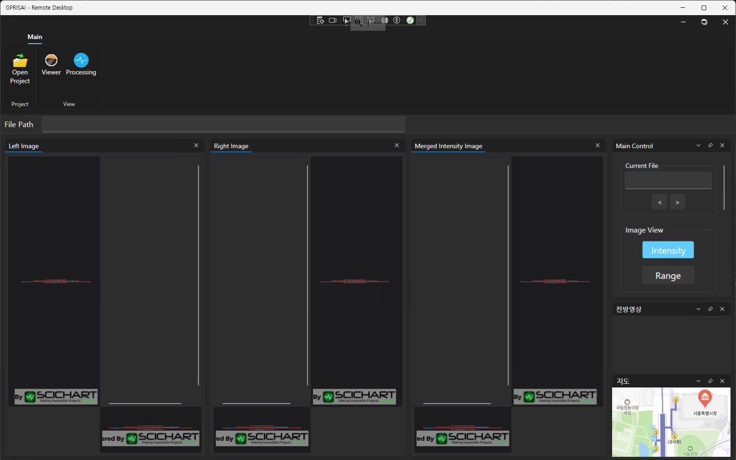
PMS road image on Static map
GPR/PMS 프로그램 NAVER Dynamic map 사용중
Static map 사용이 Naver Map service 덜 요청하고, 데이터에 따른 위치 표시등이 수월할 것으로 예상됨

Slide 4
PMS road image on Static map
Repo: https://github.com/gpris/nmapgprviewer (private)

Slide 5
Checklists
□/√ (Not done/Done)
√ WPF로 Naver Static Map표시
√ Lat/Lng로 Static map상의 위치표시
√ Line draw (Two GPS points)
√ PMS bitmap drawing
√ Rotating bitmap image base on two points src to dst
□ Road image(4m x 10m) draw based on zoom level
√ Static map zoom level study get scale factors
□ Get direction (prev position to current position)
□ Draw one line scan based on direction of GPS path.
□ Get sampling rate (PMS : 1mm /GPR : 80mm)

Slide 6
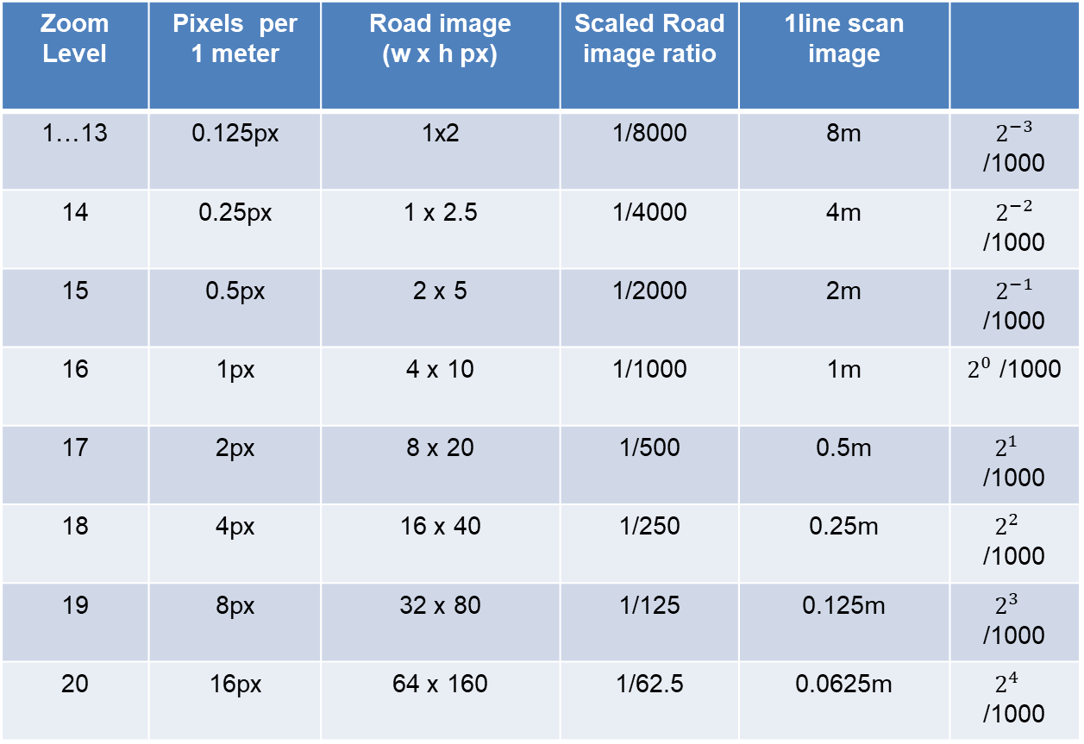
Zoom Scale factors
Zoom Level | Pixels per 1 meter | Road image (w x h px) | Scaled Road image ratio | 1line scan image
1…13 | 0.125px | 1x2 | 1/8000 | 8m | $2^{−3}$ /1000
14 | 0.25px | 1 x 2.5 | 1/4000 | 4m | $2^{−2}$ /1000
15 | 0.5px | 2 x 5 | 1/2000 | 2m | $2^{−1}$ /1000
16 | 1px | 4 x 10 | 1/1000 | 1m | $2^{0}$ /1000
17 | 2px | 8 x 20 | 1/500 | 0.5m | $2^{1 }$ /1000
18 | 4px | 16 x 40 | 1/250 | 0.25m | $2^{2 }$ /1000
19 | 8px | 32 x 80 | 1/125 | 0.125m | $2^{3 }$ /1000
20 | 16px | 64 x 160 | 1/62.5 | 0.0625m | $2^{4 }$ /1000

